Slide 1

Software engineering (Undergraduate)
Chapter 1
software & software engineering
Course Name
software engineering
CSC 3114
(Undergraduate)
Jubayer ahamed
Lecturer, CS, AIUB
jubayer@aiub.edu

Slide 2
what is Software engineering?
Slide - 2
Technologies that make it easier, faster, and less expensive to build high-quality computer programs
A discipline aiming at producing fault-free software, delivered on time and within budget, that satisfies the users’ needs.
An engineering: A set of activities in software production
The philosophy of established engineering disciplines to solve what are termed software crisis
SB

Slide 3
Scope of software Engineering
Slide - 3
The aim of Software Engineering is to solve Software Crisis:
  Late
  Over budget
  Low quality with lots of faults
Software crisis is still present over 35 years later!
SB

Slide 4
Software characteristics
Slide - 4
A logical (intangible) rather than a physical system element
Being developed or engineered but not being manufactured
Software cost concentrating in engineering, not in materials
Software does not “wearing out” but “deteriorating”(not destroyed after lifetime like hardware, but backdated by aging that needs to update)
Software is a ‘differentiator’ (different sub-systems, e.g. cashier’s workstation in a supermarket)
Without “spare parts” in software maintenance (no extra useless features in software)
Most software continues to be custom-built (based on the requirements)
SB

Slide 5
Software development life cycle (SDLC)
Slide - 5
A structured set of activities required to develop a software system
The way we produce software, including:
Planning
Requirements Analysis
Design
Development
Testing
Final release / Deployment
Maintenance
SB

Slide 6
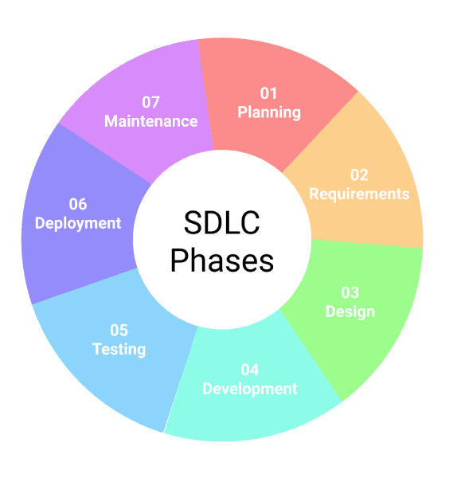
Software development life cycle (SDLC)
Slide - 6

Slide 7
Good & bad software
Slide - 7
Good software is maintained—bad software is discarded
Different types of maintenance
  Corrective maintenance [about 20%]
    Modification to fix a problem
  Enhancement [about 80%]
    Perfective maintenance (modification to improve usability,…) [about 60%]
    Adaptive maintenance (modification to keep up-to-date) [about 20%]
    Preventive maintenance (modification to avoid any future error) [about 20%]
SB

Slide 8
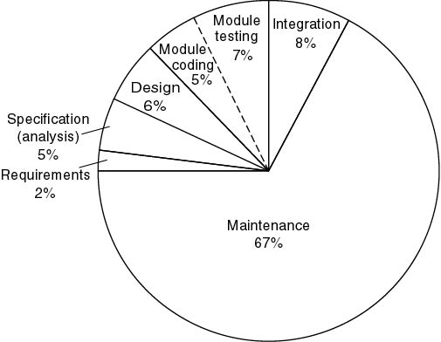
Cost of detection & correction of a fault
Slide - 9
SB

Slide 9
Software application
Slide - 10
System software (control computer hardware such as OS)
Business software (commercial application for business users [SAP, ERP])
                Systems, Applications, and Products
                Enterprise Resource Planning
Engineering and scientific software (e.g. statistical analysis-SPSS, Matlab)
Embedded software (e.g. biometric device)
Personal computer software (e.g. Microsoft Office)
Web-based software (use over the internet with a browser, e.g. Gmail)
Artificial intelligence software (e.g. HCI, Google AI)
SB

Slide 10
Software Myths (management)
Slide - 11
Myth 1: We already have a book full of standards and procedures for building software. Wouldn’t that provide my people with everything they need to know?
Myth 2: My people have state-of-the-art software development tools; we buy them the newest computers.
Myth 3: If we get behind schedule, we can add more programmers and catch up.
Myth 4: If I outsource the software project to a third party, I can relax and let that firm build it.
SB

Slide 11
Software Myths (client)
Slide - 12
Myth 1: A general statement of objectives is sufficient to begin writing programs – we can fill in the details later.
Myth 2: Project requirements continually change, but change can be easily accommodated because software is flexible.
SB

Slide 12
Software Myths (professional)
Slide - 13
Myth 1: Our job is done once we write the program and get it to work.
  Fact: the sooner you begin writing code, the longer it will take you to get done.
Myth 2: I cannot assess the program's quality until it is “running. "
Myth 3: The working program is the only deliverable work product for a successful project.
Myth 4: Software engineering will make us create very large and unnecessary documentation, invariably slowing us down.
SB

Slide 13
Why system fails?
Slide - 13
The system fails to meet the business requirements for which it was developed. The system is either abandoned or expensive adaptive maintenance is undertaken.
There are performance shortcomings in the system, which make it inadequate for the users’ needs. Again, it is either abandoned or amended incurring extra costs.
Errors appear in the developed system causing unexpected problems. Patches have to be applied at extra cost.
Users reject the implemented system, lack of involvement in its development or lack of commitment to it.
Systems are initially accepted but over time become un-maintainable and so pass into disuse.
SB

Slide 14
references
Slide - 15
R.S. Pressman & Associates, Inc. (2010). Software Engineering: A Practitioner’s Approach.
Kelly, J. C., Sherif, J. S., & Hops, J. (1992). An analysis of defect densities found during software inspections. Journal of Systems and Software, 17(2), 111-117.
Bhandari, I., Halliday, M. J., Chaar, J., Chillarege, R., Jones, K., Atkinson, J. S., & Yonezawa, M. (1994).
In-process improvement through defect data interpretation. IBM Systems Journal, 33(1), 182-214.
SB

